Slide 1
Building Sustainable Research Partnerships
All Island Research Culture Network 2025 Conference
Dr Oliver Cox (Head of Academic Partnerships, V&A and Director of Collaborative Doctoral Partnership Consortium)

Slide 2
Presentation Aims
Inbetweener or in the Sweet Spot
Crafting the Scaffolding
Tools and Techniques

Slide 3
Context

Slide 4
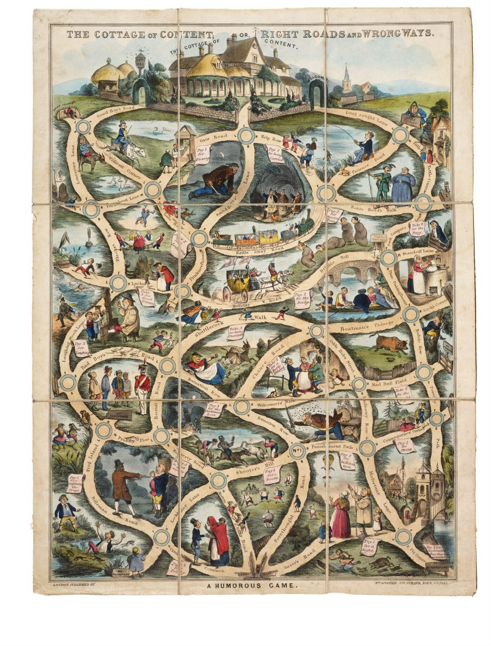
The View from the Museum
Research is content
Content is compelling
Content is the tool that organisations use to differentiate themselves.
Triple A content – accurate, authentic and accessible – is the bedrock.
Hand coloured game, The Cottage of Content, published in England by William Spooner in 1848 (E.1785-1954)

Slide 5
What is the Collaborative Doctoral Partnership scheme?
Collaborative Doctoral Partnerships are allocations of Arts and Humanities Research Council funded collaborative research studentships made to a museum, library, archive or heritage organization, or group of such organisations to allocate to collaborative PhD projects that support their work and objectives.
Across three intake years (2024, 2025 and 2026) we will fund 156 PhD Projects across 15 different cultural organisations and consortia.

Slide 6



















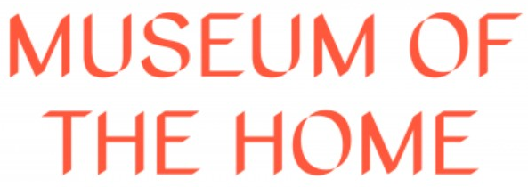












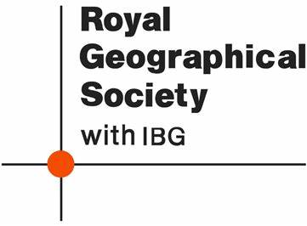




There are currently 44 organisations who are part of the Collaborative Doctoral Partnership Consortium

Slide 7
The Inbetweeners

Slide 8


Slide 9
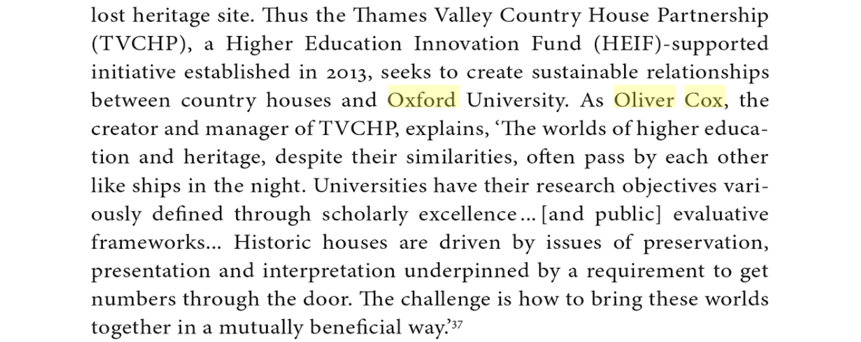
M. Finn & K. Smith (eds.), New Paths to Public Histories (Routledge, 2015), p. 33.

Slide 10
The view from the middle…
Period/Site Specific Expertise
Methodological Insights
How?
Speaking the client’s language
What?

Slide 11
Crafting the Scaffolding

Slide 12
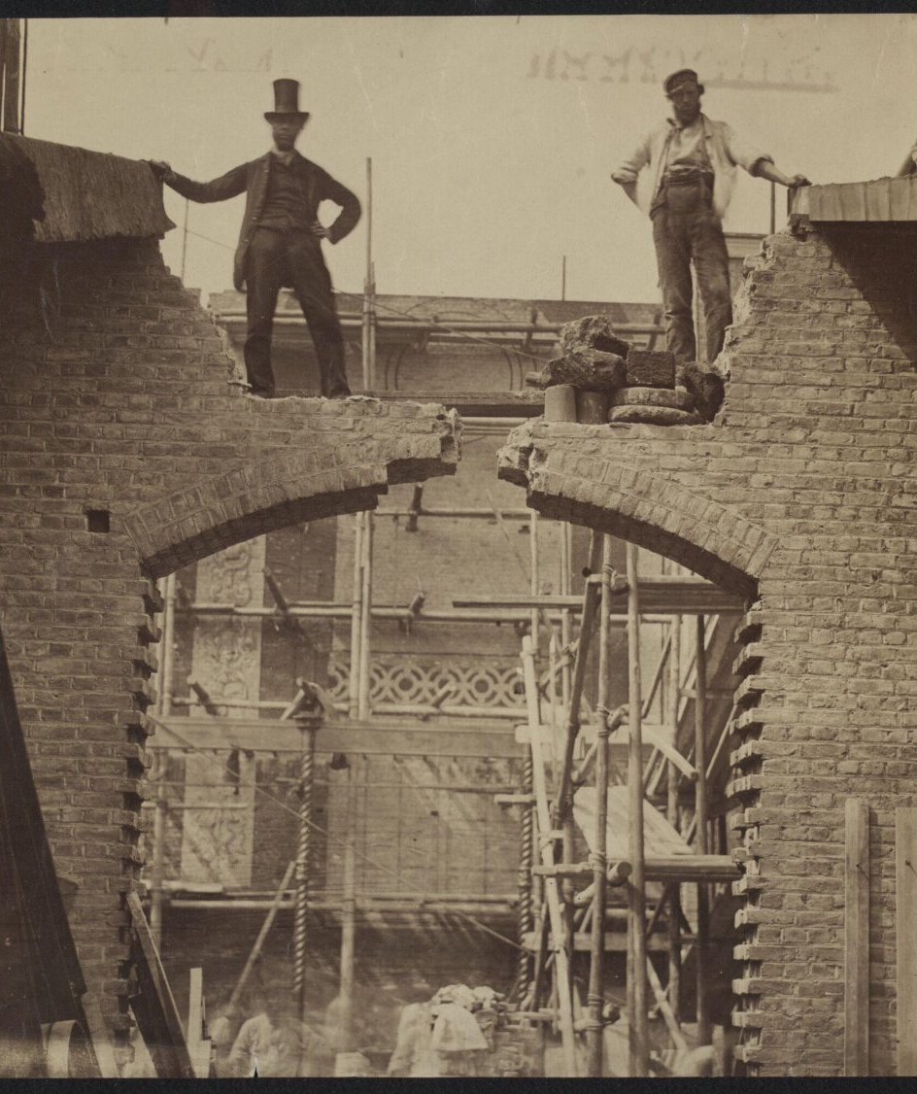
Masons, when they start upon a building,
Are careful to test out the scaffolding;
Make sure that planks won’t slip at busy points,
Secure all ladders, tighten bolted joints.
And yet all this comes down when the job’s done
Showing off walls of sure and solid stone.
So if, my dear, there sometimes seem to be
Old bridges breaking between you and me
Never fear. We may let the scaffolds fall
Confident that we have built our wall.
“Scaffolding” from Opened Ground: Selected Poems 1966–1996​ by Seamus Heaney. Copyright © 1998 by Seamus Heaney.
Testing the strength of Colonel Scott's 'newly invented' cement, for the Museum of Construction (albumen print, 9 July 1861) [E.1082-1989]

Slide 13
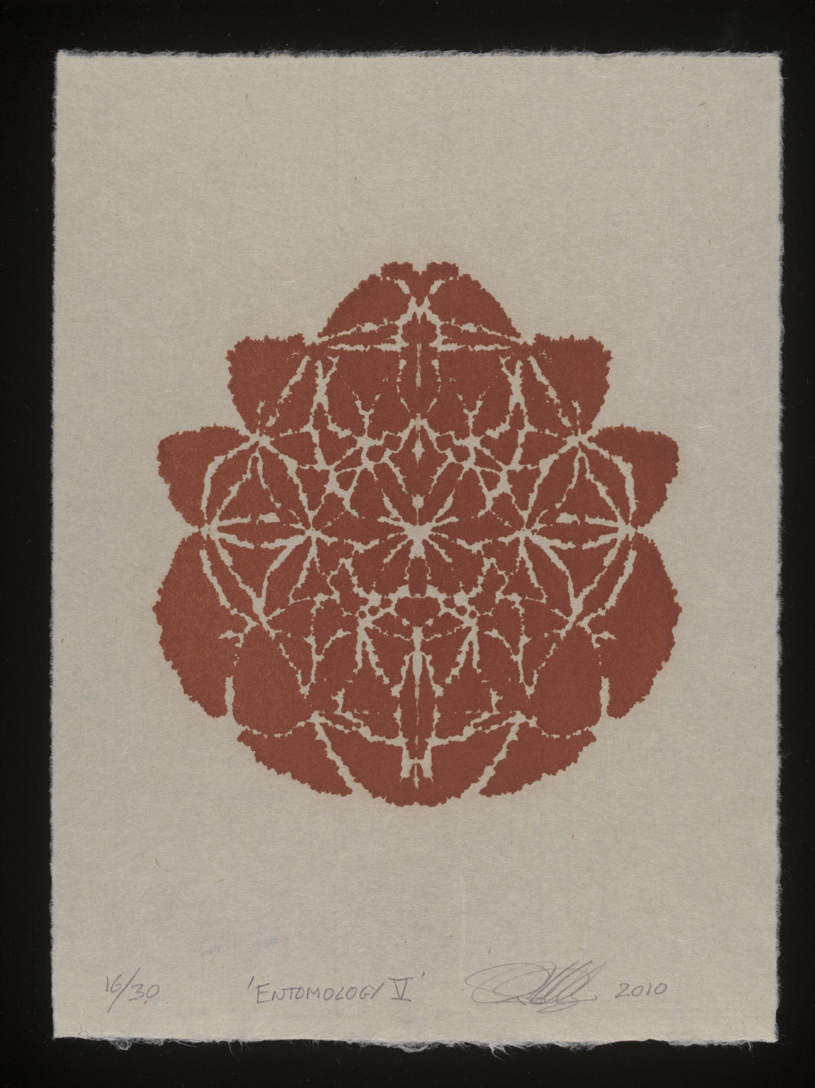
Making sure the planks won’t slip at busy joints…
Invest in the basics – why are we doing this?
The Eagle and the Woodlouse
Peter Randall-Page, Etymology V (2010) [E.955-2014]

Slide 14
Tools and Techniques

Slide 15
Reflections on working between organisations.
Understanding motivations on both sides.
Understanding potential benefits.
Being realistic about the time and financial commitments.
Being realistic about the position of research within cultural and heritage organisations.
Always aiming to find those areas of mutual benefit.

Slide 16
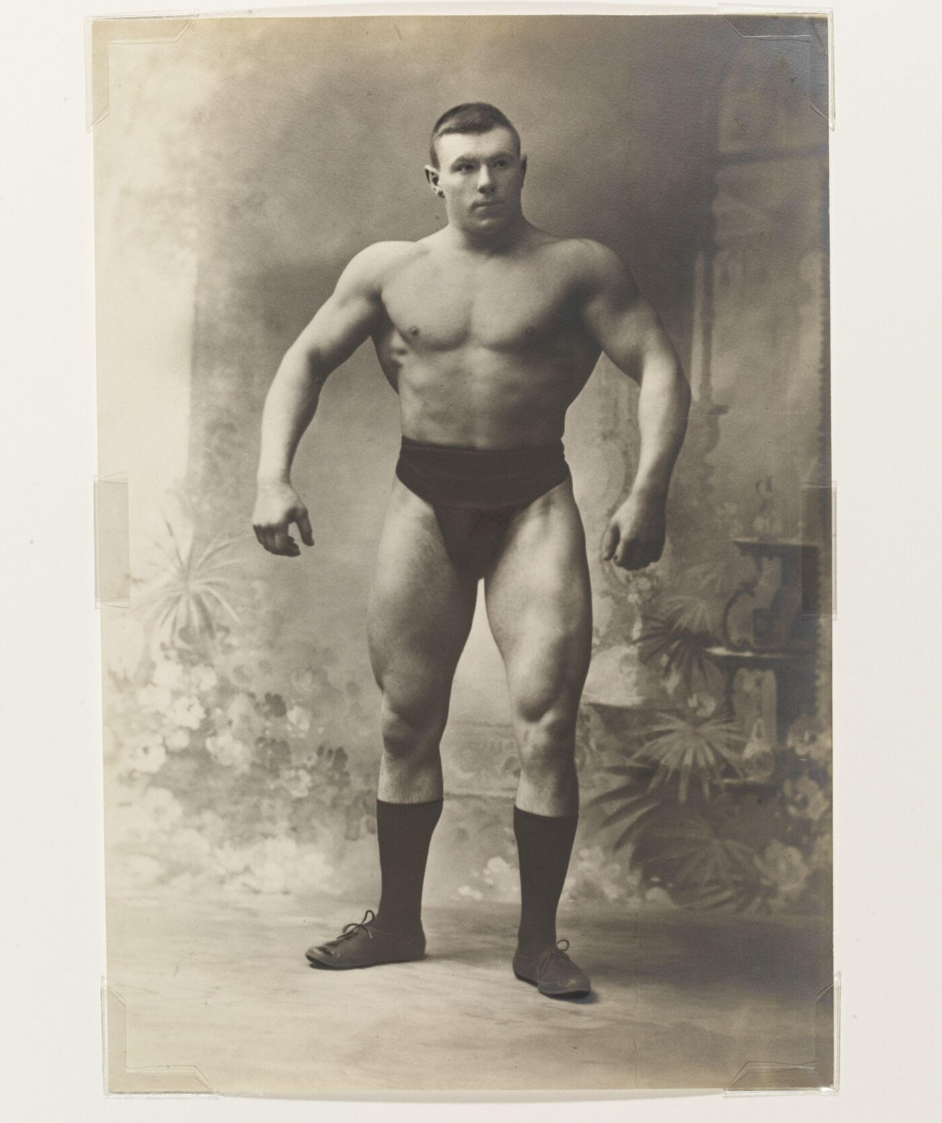
Two Key Roles…
Champion
Maverick
Photograph by Paul Martin, 'Hackenschmidt', The Russian Champion Wrestler, platinum print, c. 1895. (RPS.2250-2017)

Slide 17
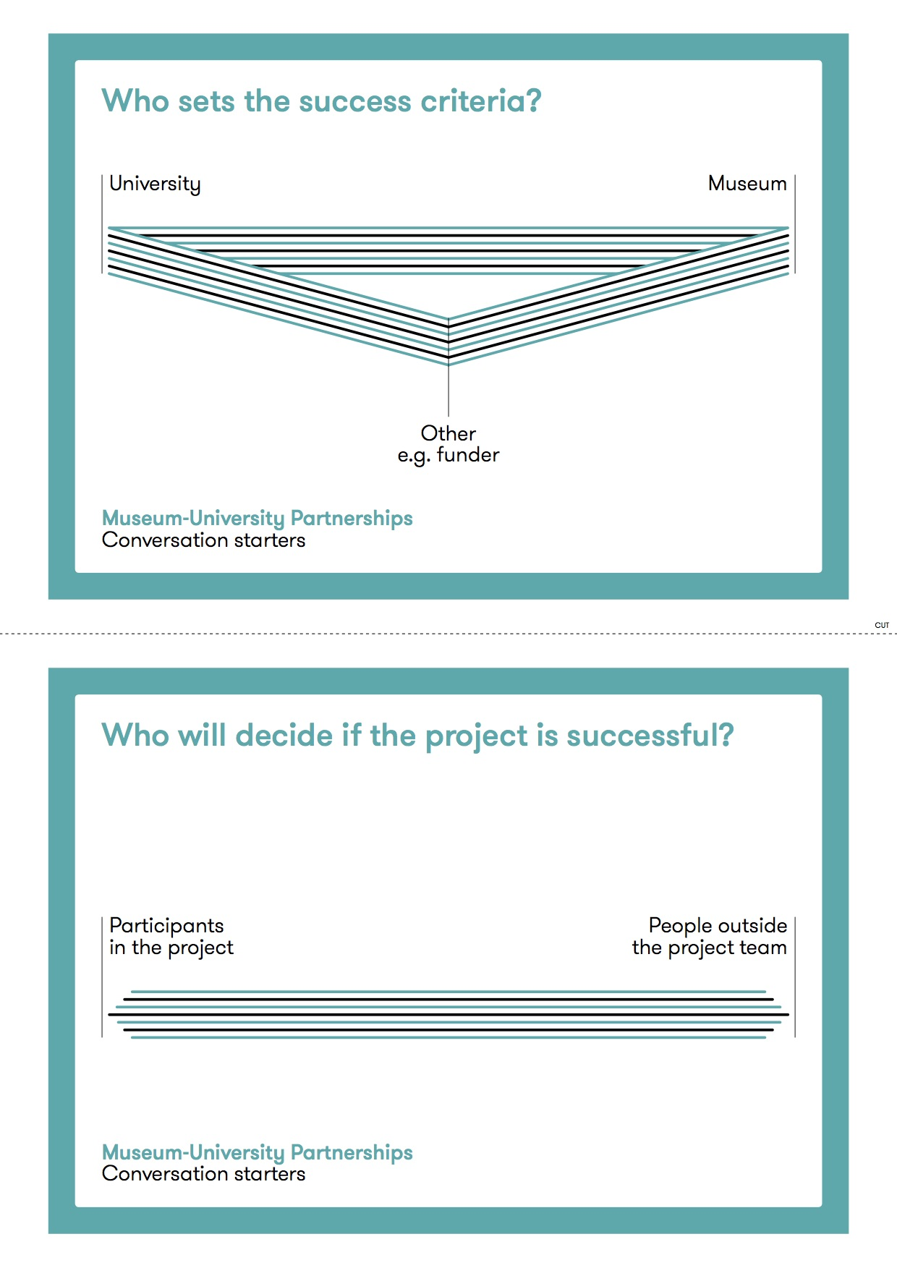
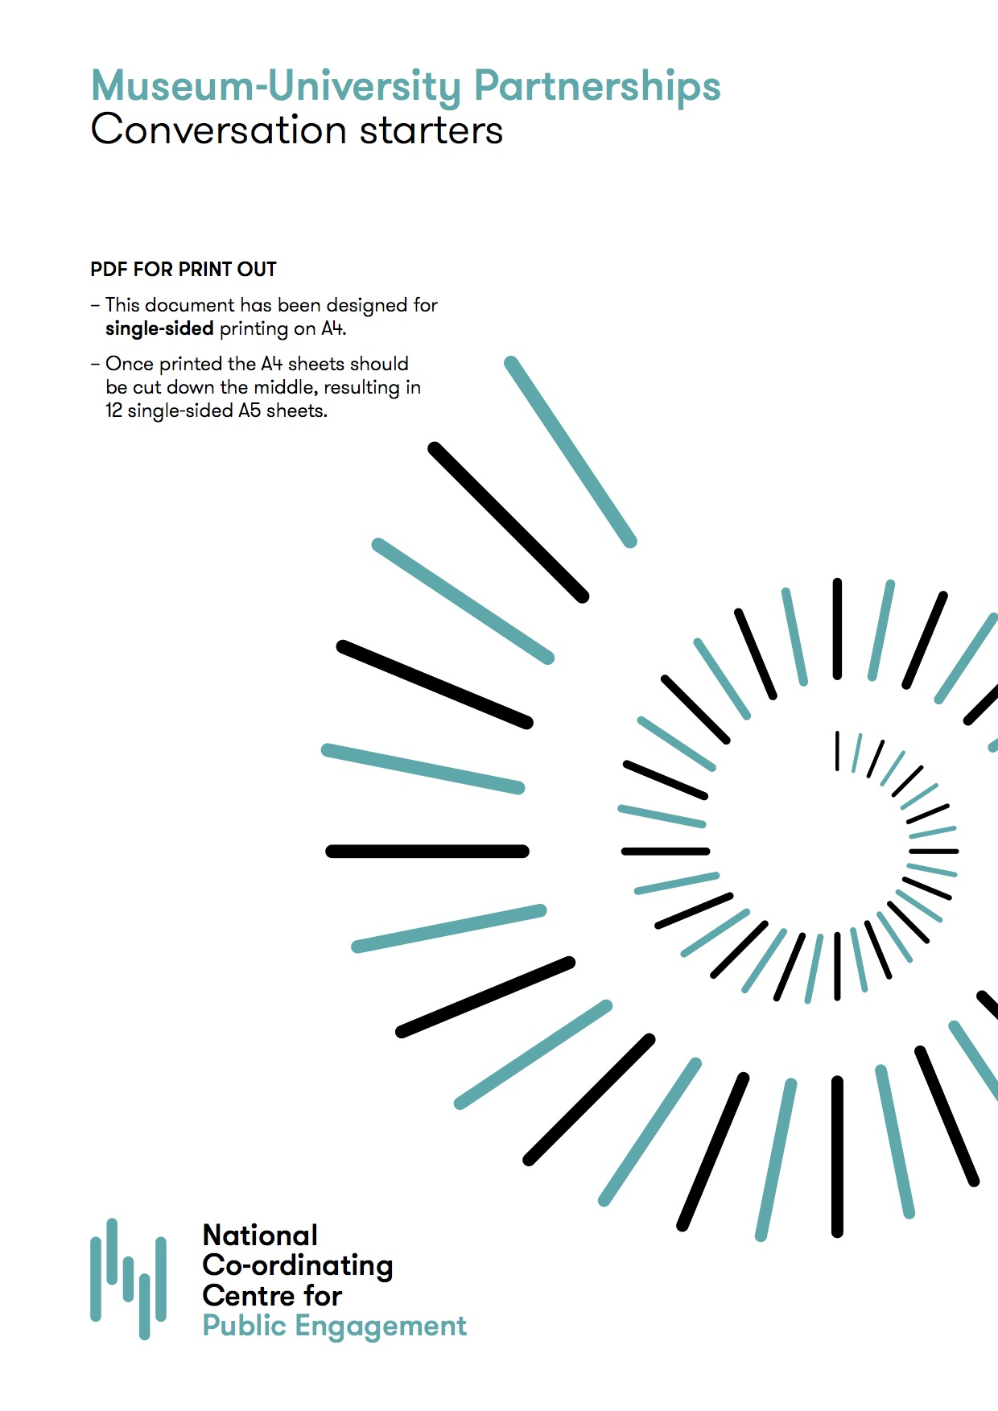
Helpful tools…

Slide 18
What’s the takeaway?

Slide 19
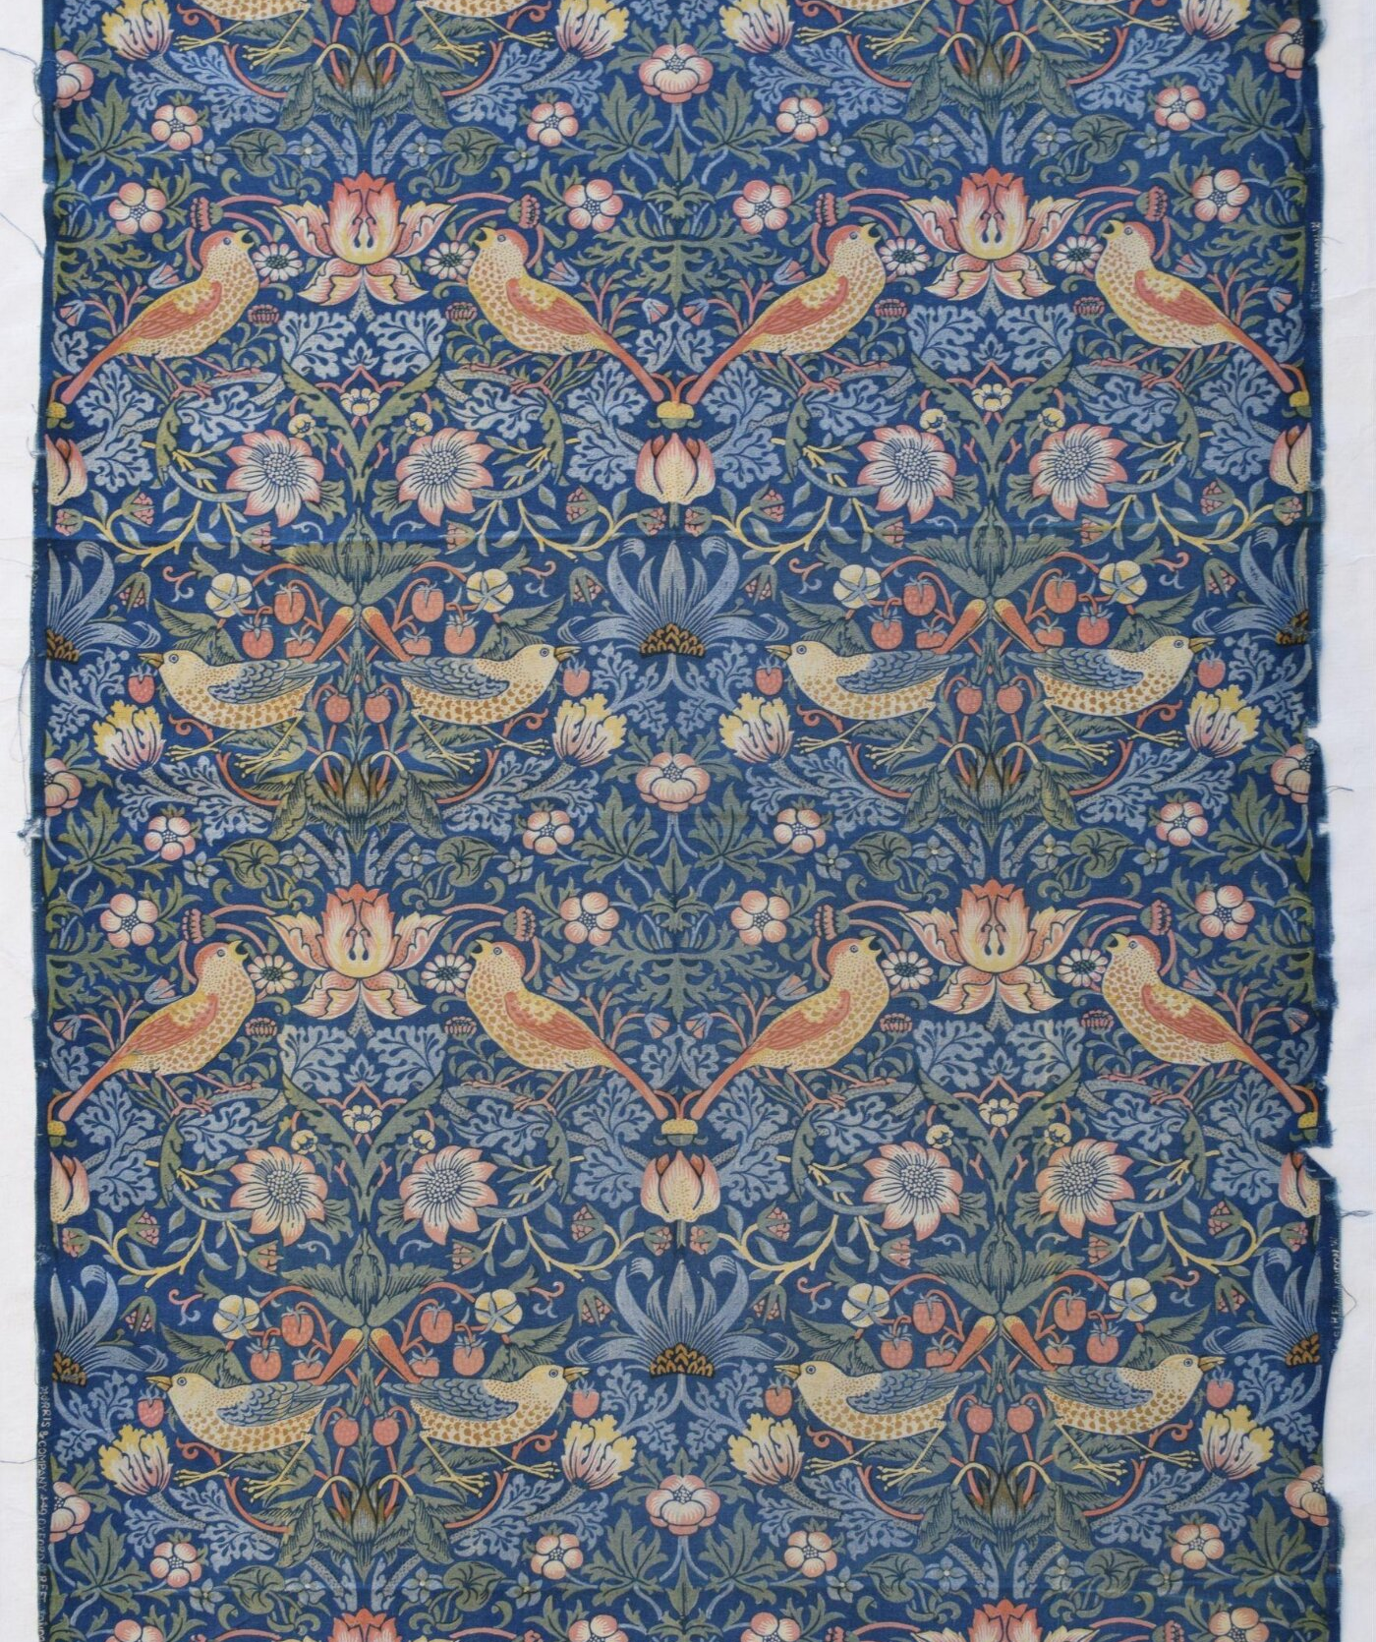
Hacker – ideas and processes that can be adapted and used, processes that can be re-engineered for your practice.
Thief – what, if anything, will you steal with pride from this session – stories, methods, language insights
?
Designed by William Morris; made by Morris & Co. at the Merton Abbey Works, near Wimbledon, London (CIRC.90-1933)

Slide 20
Thank You!
Please get in touch: o.cox@vam.ac.uk

